Slide 1


Ansible for Real-World IT Ops: Inventory
Automating IT operations for efficient infrastructure management
Content:
What is Ansible Inventory
Static Inventory –INI format
Static Inventory – YAML format
Grouping host and declaration of Children Demo: Ping with Custom port
Pinging Inventory hosts in different format ( INI, YAML and JSON).
Demonstration
Quiz time
Mini challenge
Notes:
---

Slide 2

Understanding Ansible Inventory Concepts & Structure
An inventory is a list of managed nodes (hosts) which Ansible will automate.
It can be static (INI/YAML) or dynamic (cloud plugins, scripts).
Inventories define: Hostnames /IP Address, Groupings (e.g., webservers, dbservers) ,Variables (e.g., SSH user, ports, custom settings)

Slide 3

Static Inventory in INI Format: Basic Example
[control]
localhost ansible_connection=local
[target]
target1 ansible_host= x.x.x.x
target2 ansible_host= y.y.y.y
# Explanation:
# ansible_connection=local → Used for localhost
# ansible_host → IP or DNS name of the target

Slide 4

INI Inventory with Variables and Group Hierarchies
[control]
localhost ansible_connection=local
[target]
target1 ansible_host=X.X.X.X ansible_user=ec2-user
target2 ansible_host=Y.Y.Y.Y
[all:vars]
email_server=mail.google.com
[target:vars]
email_server=mail.yahoo.com
[ITESTATE:children]
target
control

Slide 5

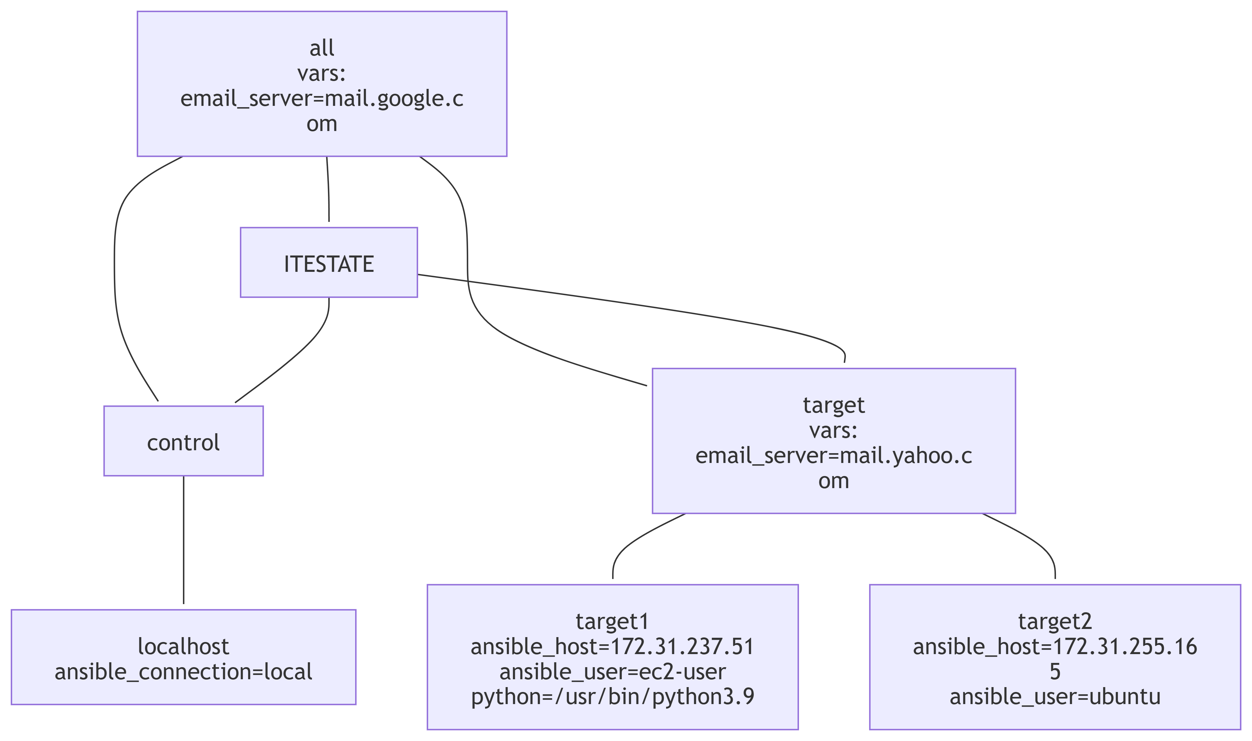
Static Inventory in YAML Format Structured Example
all:
vars:
email_server: mail.google.com
children:
control:
hosts:
localhost:
ansible_connection: local
target:
vars:
email_server: mail.yahoo.com
hosts:
target1:
ansible_host: Z.Z.Z.Z
ansible_user: ec2-user
ansible_python_interpreter: "/usr/bin/python3.9"
target2:
ansible_host: M.M.M.M
ansible_user: ubuntu
ITESTATE:
children:
target: {}
control: {}

Slide 6

Inventory Conversion: YAML to JSON for Dynamic Use
Conversion of YAML to JSON used for dynamic inventory scripts or integrations. Sample is below:
{
"all": {
"vars": {
"email_server": "mail.google.com"
},
"children": {
"control": {
"hosts": {
"localhost": {
"ansible_connection": "local"
}
}
},
"target": {
"vars": {
"email_server": "mail.yahoo.com"
},
"hosts": {
"target1": {
"ansible_host": “X.X.X.X",
"ansible_user": "ec2-user",
"ansible_python_interpreter": "/usr/bin/python3.9"
},
"target2": {
"ansible_host": “Y.Y.Y.Y",
"ansible_user": "ubuntu"
}
}
},
"ITESTATE": {
"children": {
"target": {},
"control": {}
}
}
}
}

Slide 7
How Ansible Merges Variables
Inventory Flowchart
Start
[ansible.cfg]
[Inventory Source]
| Static Inventory (INI/YAML)
| Dynamic Inventory (Scripts/Plugins)
[Inventory File Parsed]
[Hosts & Groups Identified]
[Variables Loaded]
| group_vars/
| host_vars/
| all/group/host level vars
[Variable Precedence Applied]
[Inventory Graph Built]
[Playbook Execution Begins]
[Tasks Executed per Host]
End
Ansible combines variables from multiple sources and applies precedence rules to decide which values take effect. This ensures that the correct variable is used for each host during playbook execution.
Key Points:
Variables defined higher in the inventory hierarchy override those defined lower.
Before running a play, Ansible flattens all variables for each host, so the host has a single set of resolved values.
By default, Ansible overwrites variables when conflicts occur (controlled by DEFAULT_HASH_BEHAVIOUR).
Inventory Precedence Order (Lowest → Highest)
all group (parent of all groups)
Parent group
Child group
Host-specific variables
If two groups are at the same level, Ansible merges them alphabetically. Variables from the later group overwrite earlier ones.

Slide 8

Live Demo Plan: Inventory Setup and Testing
Inventory Setup
Preparing ansible.cfg .
Preparing hosts file
host_key_checking
Pinging servers without adding host_key_checking
Adding host_key_checking and re-test ping
Listing hosts
Variables and Children(Included in slides and demo)
INI to YAML Conversion
YAML to JSON Conversion
Graph visualization
Pinging email server of Target

Slide 9

Quiz Section
Question | Answer | Explanation
What is an inventory in Ansible? | A list of managed nodes | Inventories define hosts and groups for automation
Which formats can static inventory use? | INI and YAML | Both formats are supported for static inventories
What is the default inventory file name? | hosts | Ansible uses 'hosts' by default unless overridden
Which command lists hosts in a group? | ansible <group> --list-hosts | Displays all hosts under a group
Which module is used to test connectivity? | ping 'ansible all -m ping' | checks connectivity
What does ansible_connection=local mean? R | un tasks locally | Used for localhost in inventory.
Which variable sets SSH user? | ansible_user | Overrides default SSH user for a host/group.
Which variable sets SSH port? | ansible_port | Overrides default SSH port (22).
How do you disable host key checking? | host_key_checking=false | Set in ansible.cfg or env variable.
What is a child group in inventory? | A subgroup under a parent | Defined using '[parent: children]'.
Which group has lowest precedence? | all | It is the parent of all groups.
Which has highest precedence? | Host-specific vars | Overrides all group-level vars
How does Ansible merge same-level groups? | Alphabetically | Later group overwrites earlier ones
Which variable changes merge order? | ansible_group_priority | Higher number = higher priority
Where can ansible_group_priority be set? | Inventory source | Not in group_vars
Which command shows inventory graph? | ansible-playbook --graph | Displays task execution order.
What is DEFAULT_HASH_BEHAVIOUR? | Controls variable merge | Determines overwrite vs merge behavior.
Which plugin enables dynamic inventory? | aws_ec2 | Example for AWS EC2 dynamic inventory.
What does inventory_hostname represent? | Current host name | Used in playbooks for referencing host.

Slide 10

Hands-On challenge: Inventory Simulation & Variable Precedence
Challenge 1: Inventory Graph Visualization
Goal: Use --graph to visualize task execution order.
Steps:
Write a playbook with multiple roles and tasks.
Run ansible-playbook playbook.yaml --graph > graph.dot.
Convert DOT to PNG using Graph viz (dot -Tpng graph.dot -o graph.png).
Expected Outcome: Learners understand task dependencies and how to visualize them.
Challenge 2: Conversion of INI inventory to Yaml
Goal: Practice converting inventory formats.
Steps:
Convert an INI inventory to YAML.
Convert YAML to JSON using the Python one-liner from the notes. Expected Outcome: Learners understand inventory format flexibility.
Challenge 3: Host Key Checking Behavior
Goal: Understand SSH key checking.
Steps:
Run ansible all -m ping with and without host_key_checking.
Modify ansible.cfg and observe the difference. Expected Outcome: Learners know how to handle SSH key issues.

Slide 11

What’s Next?
Discuss Ansible Architecture and Design using below
Ansible variable precedence

